Slide 1
ATAI
Chongqing University of Technology
Advanced Technique of Artificial Intelligence
Chongqing University of Technology
ACL2020 @ A Novel Graph-based Multi-modal Fusion Encoder for Neural Machine Translation
Binyan Zhang
zby@2018.cqut.edu.cn
2020.11.2 • ChongQing

Slide 2
Outline
Background
Motivation
Approach
Experiments
Conclusion
Notes:
接下来我们将从这五个方面来介绍这篇文章

Slide 3
Background
original text：
Man padding a boat on a river near the bank;
Translation:
男子在银行附近的一条河上划着船；
男子在河岸附近的一条河上划着船。
EN CH

Slide 4
Background
Encoding each input image into a global feature vector;
2） Extracting object-based image features to initialize the model,
or supplement source sequences;
3) Representing each image as spatial features, which can be exploited as extra context.

Slide 5
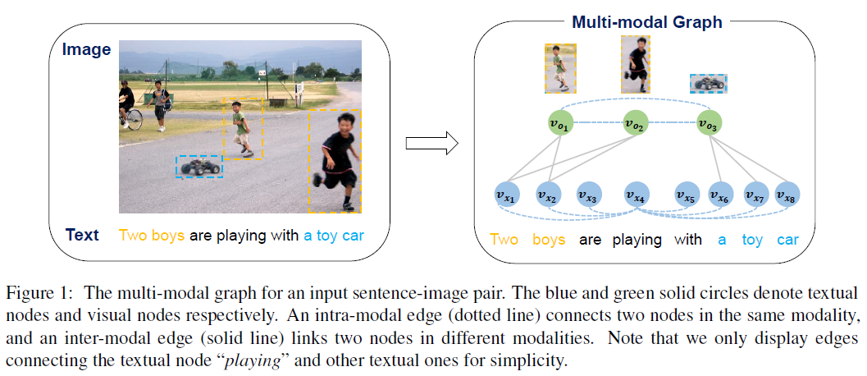
Motivation

Slide 6
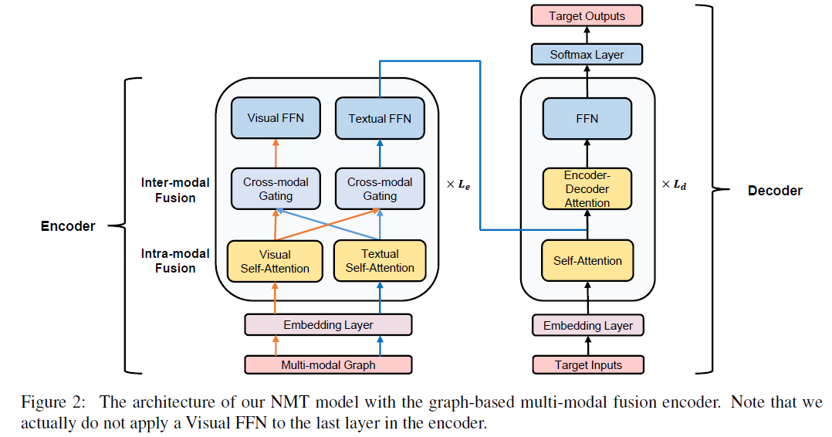
Approach
Encoder:
[1] Zhengyuan Yang. 2019. A fast and accurate one-stage approach to visual grounding. In Proceedings
of ICCV 2019, pages 4682–4692.

Slide 7
Approach
Decoder:

Slide 8
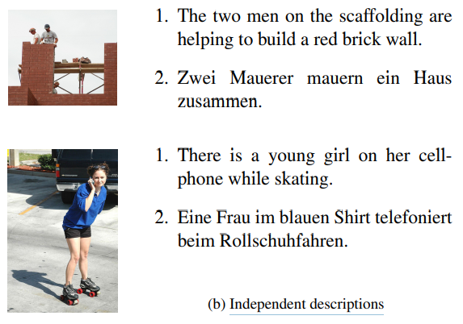
Experiments
Examples in the Multi30K dataset:

Slide 9
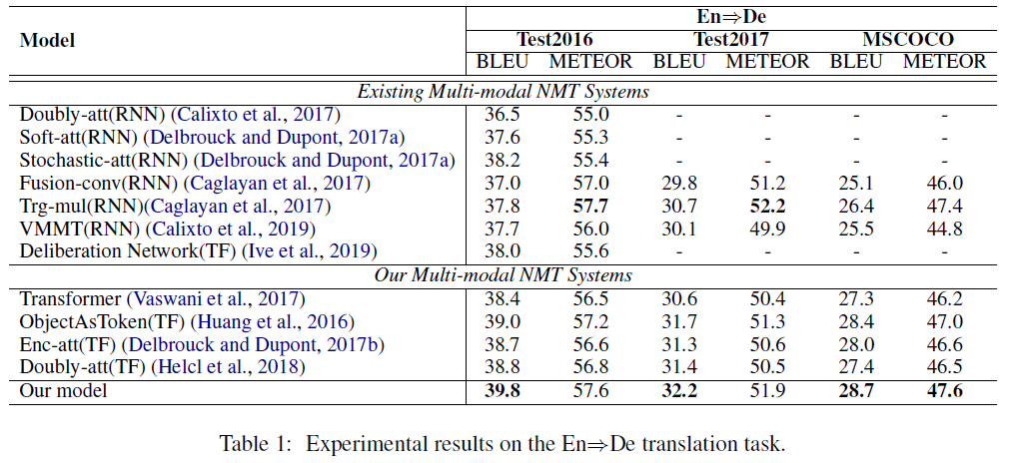
Experiments

Slide 10
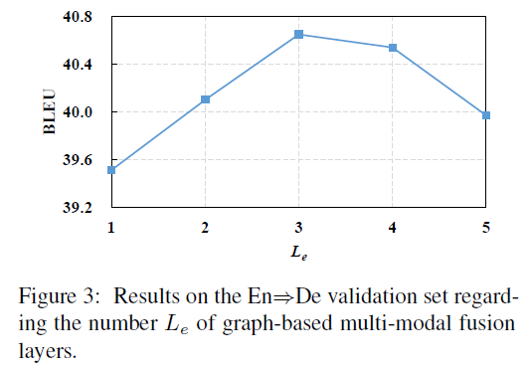
Experiments
Parameter sensitivity experiment:

Slide 11
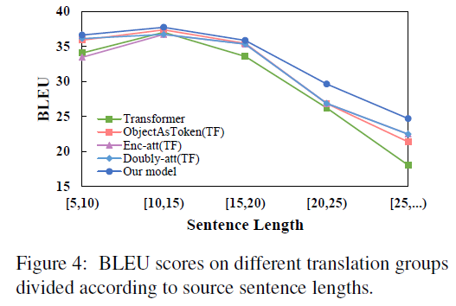
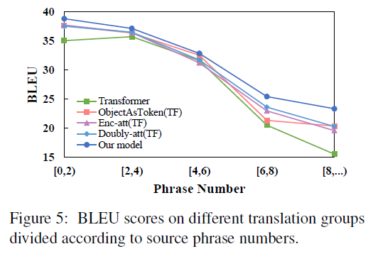
Experiments

Slide 12
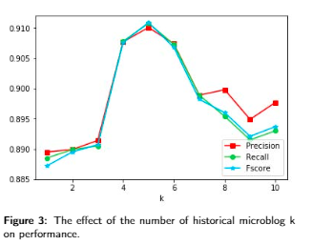
Experiments

Slide 13
Experiments
Ablation study:

Slide 14
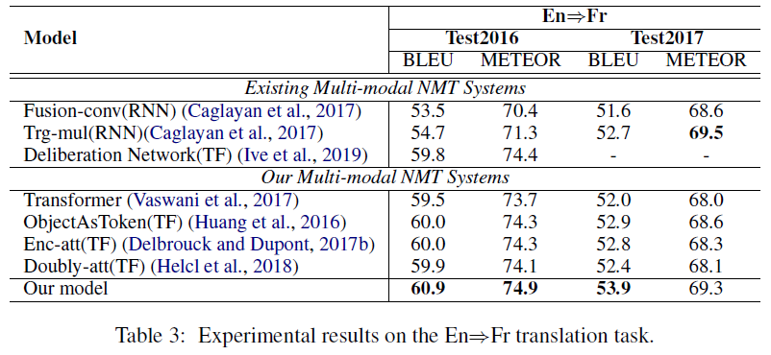
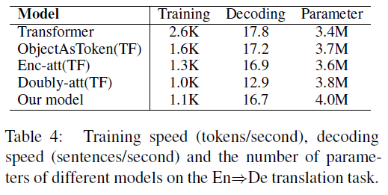
Experiments

Slide 15
Experiments
Case study:

Slide 16
Conclusion
It first learn the contextual representation of each node within the same modality, so that it can better determine the degree of inter-modal fusion according to its own context.
2) It assign different encoding parameters to different modalities, which has been
shown effective in our experiments.

